Slide 1
MABSPACE
CONTENT PLAN
MAY

Slide 2

Post 1 - Mabspace Published Video (Reupload)
IDEA
Reupload the existing published and boost it with a big budget to gain traction.
Caption
Additional Info
Re Upload existing video with new caption
Boost Video with a high budget targeted at awareness.
Date to be published :

Slide 3

Post 2 - Content Writer Statistic.
IDEA
The can should have the stat wanted to be portrayed in a creative visual format.
73% of companies hire someone to do their content strategy.
(carminemastropierro.com)
Caption
Additional Info
Find a engaging stat
Place Stat in a creative format on the Mockup
Create Caption Date to be published :

Slide 4


Post Concept 3 - Graphic Designer Work Showcase (Reference 01)
IDEA
A image showcasing the designers work alongside a picture of the designer to increase credibility.The caption mentioned showed be a friendly introduction of the designer with the call to action being to connect with him on Mabspace.
Caption
Additional Info
Get in touch with a designer and get his best portfolio work to feature
Create engaging visual with designer and work done with intro to who the designer is and to get in touch with him on Mabspace. Date to be published :

Slide 5
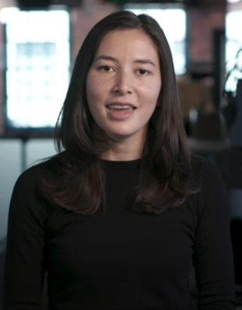
Post 4 - Jehani (Founder) Story of Mabspace
IDEA
Create a video of Jehani speaking about Mabspace in a fun,emotional and engaging manner.
Caption
Additional Info
Script Breakdown (What to cover)
Tone and feel of Video
Filming and execution with B Roll footage
Caption and Post Publication. Date to be published :

Slide 6
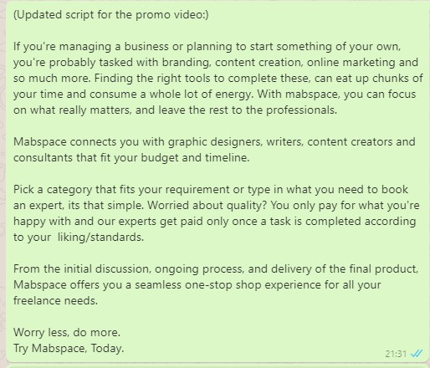
Post 05 - Try Mabspace Today
IDEA
Create a fun and engaging video describing what Mabspace has to offer.
Caption
Additional Info
Create Video Script (Done)
Create Voice Overlay (Done)
Create Caption for Post
Create animation for Video Date to be published :

Slide 7

Post 06 - Customer Video Testimonials
IDEA
Get a group of people of to talk about how mabspace has benefited them also mentioning some key points like - Easy of use, Reliable, etc
Caption
Additional Info
Create Video Script
Create Caption for Post
Get people on board to be the subject for the video Date to be published :

